Slide 1
Technology of nuclear industry

Slide 2
Definitions of nuclear technology, weapon and power
Nuclear technology is technology that involves the nuclear reactions of atomic nuclei.
A nuclear weapon is an explosive device that derives its destructive force from nuclear reactions, either fission (fission bomb) or from a combination of fission and fusion reactions (thermonuclear bomb). Both reactions release large quantities of energy from relatively small amounts of matter. Nuclear weapons are considered weapons of mass destraction.
There are two basic types of nuclear weapons: those that derive the majority of their energy from nuclear fission reactions alone, and those that use fission reactions to begin nuclear fusion reactions that produce a large amount of the total energy output.

Slide 3
.Some nuclear weapons are designed for special purposes; like
Neutron bomb is a thermonuclear weapon that yields a relatively small explosion but a relatively large amount of neutron radiation.
Nuclear power is a type of nuclear technology involving the control use of nuclear fission to release energy for work including propulsion, heat, and the generation of electricity.
. Nuclear energy is produced by a controlled nuclear chain reaction which creates heat and which is used to boil water, produce steam , and drive a steam turbine . The turbine is used to generate electricity to do mechanical work.
.Nuclear power is one of the leading low carbon power generation methods of producing electricity.

Slide 4
RAW MATERIAL FOR NUCLEAR WEAPEN AND POWER
The most commonly used fissile materials for nuclear weapons applications
are :
Uranium and
Plutonium
Less commonly used has been:
Uranium_233
Neptunium
And some isotopes of americium may be usable for nuclear explosives.

Slide 5
Nuclear weapon production process and BFD
Major unit operations of nuclear weapon
1. Uranium mining , milling and refining
2. Isotope separation
3. Fuel and target fabrication
4. Reactor operations
5. Chemical separation
6. Weapons component fabrication
7. Weapons operations
8. Research, development and testing

Slide 6
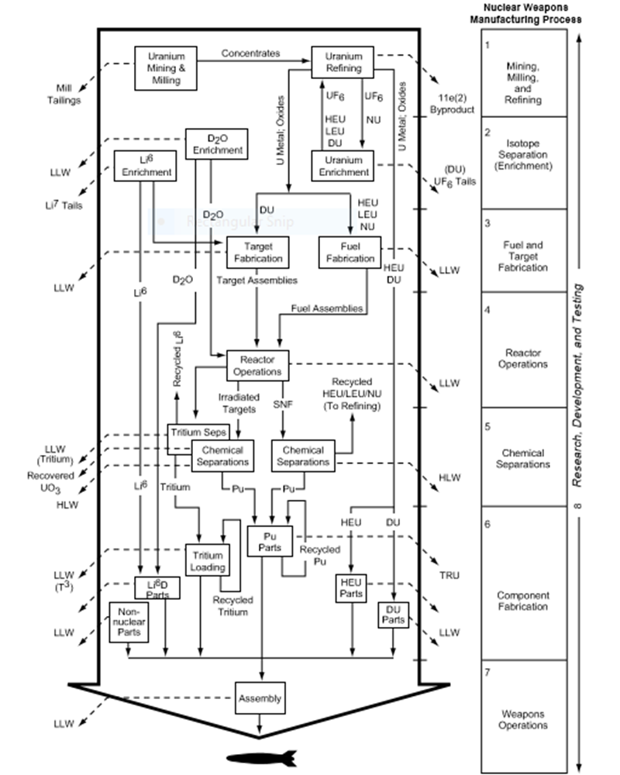
BFD of nuclear weapon

Slide 7
Process and major unit operation of nuclear power
1. Nuclear Reactor
2. Heat Exchanger
3. Steam Turbine
4. Alternator
Nuclear reactor is used to produce heat and heat exchanger performs to convert water into steam by using the heat generated in nuclear reactor. This steam is fed into steam turbine and condensed in condenser.
Now steam turbine is turn to run an electric generator or alternator which is coupled to steam turbine and thereby producing electric energy. This is a very basic working principle of Nuclear power plant.

Slide 8
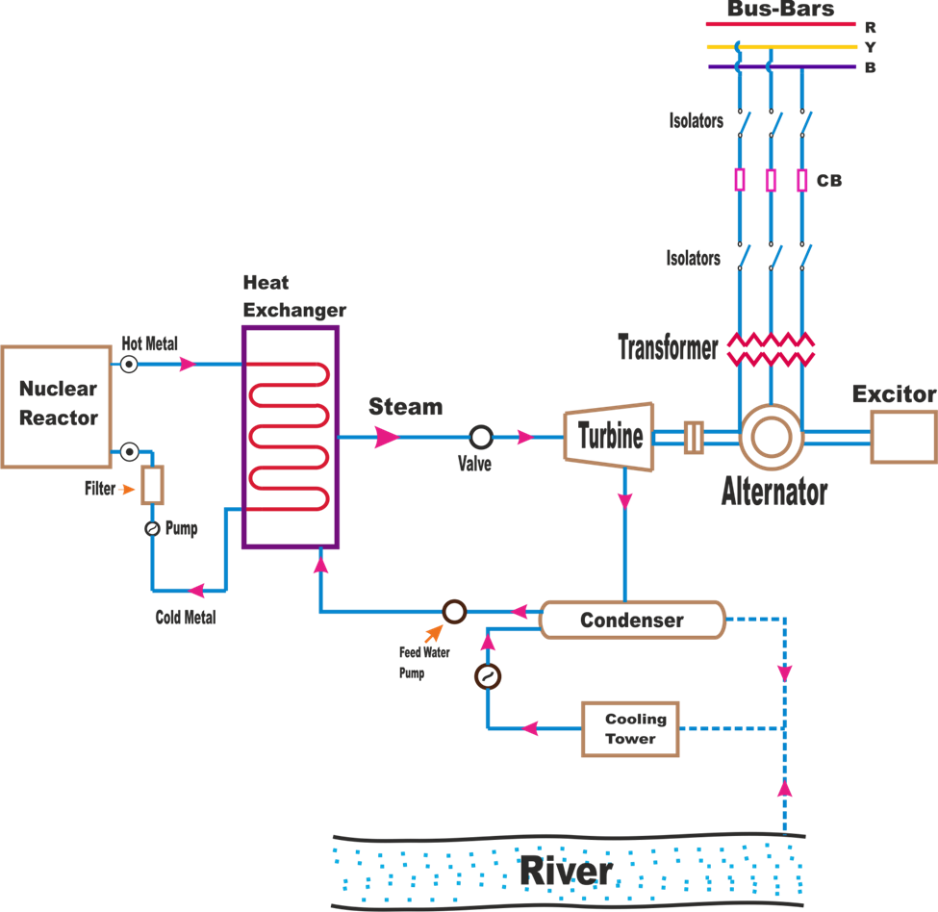
BLOCK DIAGRAM OF NUCLEAR POWER

Slide 9
Detail process
1. Nuclear Reactor:
Nuclear reactor is the main component of nuclear power plant and nuclear fuel is subjected to nuclear fission. Nuclear fission is a process where a heavy nucleus is spitted into two or more smaller nuclei. . A heavy isotope generally uranium-235(U-235) is used as a nuclear fuel in the nuclear reactor because it has the ability to control the chain reaction in the nuclear reactor. Nuclear fission is done by bombarding uranium nuclei with slow moving neutrons. The energy released by the fission of nuclei is called nuclear fission energy or nuclear energy. By the braking of uranium atom, tremendous amount of heat energy and radiation is formed in the reactor and the chain reaction is continuously running until it is controlled by a reactor control chain reaction. A large amount of fission neutrons are removed in this process, only small amount of fission uranium is used to generate the electrical power.

Slide 11
By product of Nuclear Weapon(Nuclear Waste)
There are roughly three levels of wastes, divided by their immediate danger to nature and humankind:
1. Low-level waste (LLW): is compromised of daily objects used in nuclear power plants, such as clothing, filters, tools, etc.
90% of the volume of all nuclear wastes,
1% of the radioactivity.
it does not need to be isolated from environment during handling and transportation.
Contaminats ; clothing , hand tool ,water purifier

Slide 12
2.Intermediate-level waste (ILW): includes materials or tools used in facilitation of nuclear power plants, such as resins, chemical sludge, and contaminated materials from reactor decommissioning.
It takes up 7% of the total volume and 5% of the radioactivity, as it includes higher concentrations of beta/gamma contamination and sometimes even alpha contamination. It has low heat-emission.
High-Level Waste (HLW): is the direct byproduct of operating nuclear power plants. It includes the used fuel rods or wastes from reprocessing them. Unlike other levels of waste, HLW emits decay heat that requires cooling in its handling. While its volume only takes up 3%, it accounts for over 95% of radioactivity
.Waste relative to other types
In countries with nuclear power, radioactive wastes account for less than 1% of total industrial toxic wastes, much of which remains hazardous for long periods.

Slide 13
Environmental Impact of nuclear Technology
** The environmental impact of nuclear power results from the nuclear fuel cycle, operation, and the effects of nuclear accidents.
The greenhouse gas emissions from nuclear fission power are much smaller than those associated with coal, oil and gas, and the routine health risks are much smaller than those associated with coal. However, there is a "catastrophic risk “potential if containment fails , which in nuclear reactors can be brought about by overheated fuels melting and releasing large quantities of fission products into the environment.
1-Radiation
2- None renewable
3- Can be used for developing nuclear weapons
4- Huge building cost Though a large amount of energy can be produced from a nuclear power plant, it requires a large capital cost.

Slide 14
5- Nuclear waste: The waste produced after fission reactions contains unstable elements, and is highly radioactive. It is very dangerous to the environment as well as human health and remains so for hundreds of years.
6- Nuclear power plant accidents
7- Decommissioning of nuclear power stations is expensive and takes a long time.
8- Water pollutant
Human impact of nuclear power
*Forced evacuation from a nuclear accident may lead to social isolation, anxiety, depression, psychosomatic medical problems, reckless behavior, even suicide.

Slide 15
Advantages of nuclear power
1- Produces large amount of energy
2-It is green energy
3-No air pollution
4-Fuel independence
5- Space limitations
6- Nuclear energy is by far the most concentrated form of energy - a small mass of fuel produces a lot of energy.
7- Nuclear power is a reliable type of energy source.
8-We can control the output from a nuclear power plant to fit our needs.
9- Nuclear power produces a small volume of waste although that waste is radioactive.
10- Low maintenance

Slide 16
Applications Of Nuclear Technology
1.Medical application:
The medical applications of nuclear technology are divided into diagnostics and radiation treatment.
The largest use of ionizing radiation in medicine is in medical radiography to make images of the inside of the human body using x-rays.
2. Industrial application:
Since some ionizing radiation can penetrate matter, they are used for a variety of measuring methods. X-rays and gamma rays are used in industrial radiography to make images of the inside of solid products, as a means of nondestructive testing and inspect.

Slide 17
3. Commertial application:
Radioluminescence.
tritium illumination: Tritium is used with phosphor in rifle sights to increase nighttime firing accuracy. Some runway markers and building exit signs use the same technology, to remain illuminated during blackouts.
Betavoltaics.
Smoke detector: An ionization smoke detector includes a tiny mass of radioactive americium-241, which is a source of alpha radiation.
4.Food processing and agriculture
In biology and agriculture, radiation is used to induce mutations to produce new or improved species. Another use in insect control is the sterile insect technique, where male insects are sterilized by radiation and released, so they have no offspring, to reduce the population.
In industrial and food applications, radiation is used for sterilization of tools and equipment. An advantage is that the object may be sealed in plastic before sterilization. An emerging use in food production is the sterilization of food using food irradiation.

Slide 18
SUMMERY
Generally nuclear technology industries are industries that involves the nuclear reactions of atomic nuclei. From this we are mainly focused on the technology of nuclear weapon and nuclear power. nuclear weapon is an explosive device that derives its destructive force from nuclear reactions, either fission (fission bomb) or from a combination of fission and fusion reactions (thermonuclear bomb).and also nuclear power is a type of nuclear technology involving the control use of nuclear fission to release energy for work including propulsion, heat, and the generation of electricity. Nuclear technology uses a raw material called uranium and Plutonium mainly for technological process. This technology have radioactive wastes or by products with three levels of waste( low, intermidate and high levels).under this nuclear weapon and power technology there are different types of environmental and human impact but it has a wide range of applications in food processing and agriculture, commertial , medical and industrial applications. the nuclear power or energy has a lot of advantages such as Production of large amount of energy, No air pollution, Fuel independence and so on.

Slide 19
Thank you for your attention

